Slide 4

Using the terminal

Slide 5
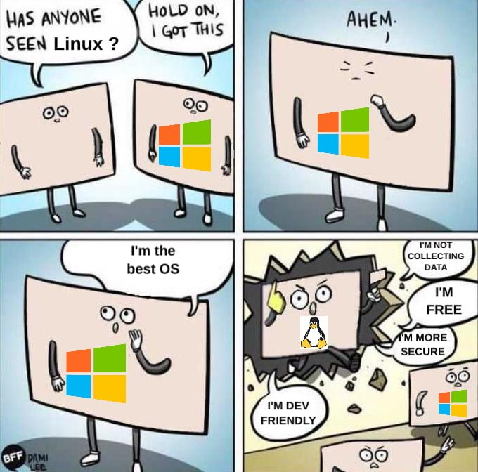
What is shell/terminal and why use it?
An interface to the computer
Similar to a graphics user interface
Allows for advanced processing and streamlining compared to clicking over and over again
Can be used on machine that don't have a GUI

Slide 6

Assumptions
We are currently somewhere on the computer
We have certain permissions based on what kind of user we are – SUDO
Every command has options and inputs specified before or after e.g. rm –r –f /home
To see options do command --help

Slide 7

Navigating file system
ls - list content in the directory you are currently in with options: -l for detailed view, -a for hidden files.
Cd - Change directory.
pwd - Print working directory.

Slide 8
Make directories and files
mkdir – make a new directory e.g. mkdir test
rmdir - remove an empty directory
touch – create a new file e.g. touch test.txt

Slide 9
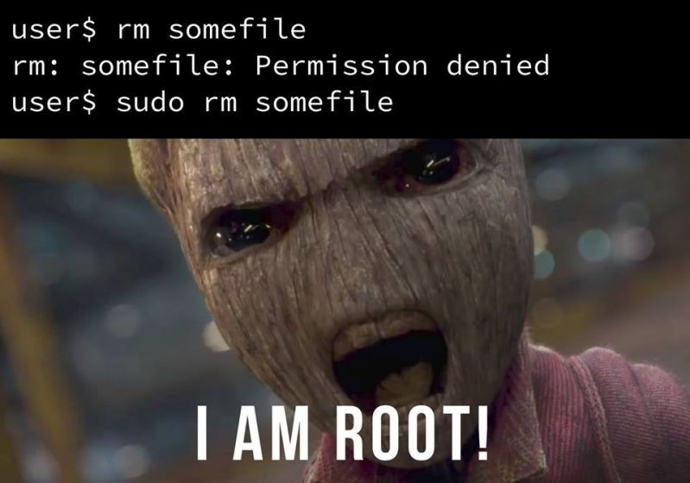
Manipulate files
cp: Copy files or directories. Options: -r for recursive copy. Slow for large files
mv: Move or rename files or directories. Fast regardless of size (changing pointer)
rm: Remove files or directories. Options: -r for recursive removal for directories. NOTE: there is no bin so files disappear for good

Slide 10

Viewing and Editing Files
cat: Concatenate and display file content.
less: View file content page by page.
nano/vim: Basic text editors for editing files built into the terminal, e.g. vim file.py

Slide 11

File Transfer
scp: Secure copy for transferring files between computers.
Basic syntax: scp source_file user@host:destination_path
Example: scp lots_of_data.zip maia-user@maia.cloud.cbh.kth.se:~/Desktop will move the zip to your desktop
Options: -r recursively, -P ports

Slide 12
Searching and Finding Files
Find command
Example 1: Find a File by Name:
find /path/to/search -name "filename.txt"
Example 2: Find Files by Extension:
find /path/to/search -type f -name "*.txt"
grep command
Example: Search for a Pattern in a File:
grep "search_term" filename.txt

Slide 13
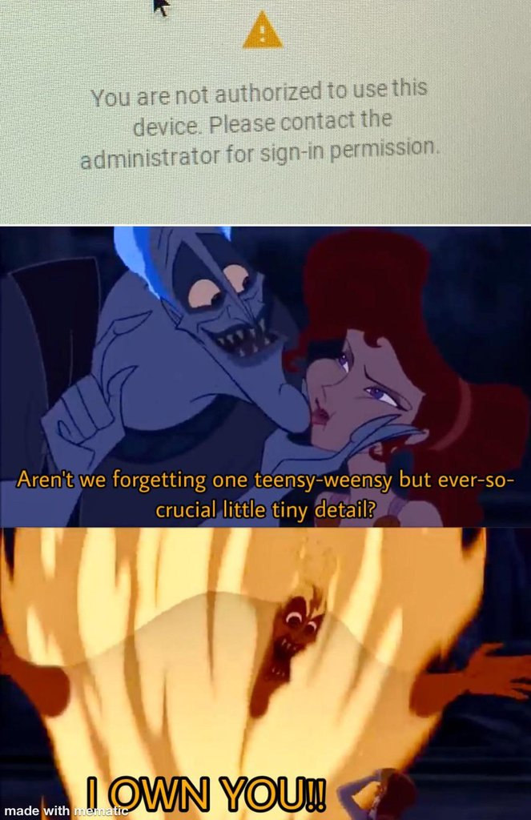
Ownership and permissions
Chmod command
Example 1: Change File Permissions for other**
chmod a+x script.sh
Options: ugo – rwx, user/group/other - read/write/execute
chown command
Example: Change Ownership Recursively:
chown -R newuser:newgroup /path/to/directory

Slide 14
Download the terminal_use.ipynb and try out the exercises: https://github.com/kthcloud/Computer-Science-Workshop
Memes from: nanimeme.com

